Slide 1
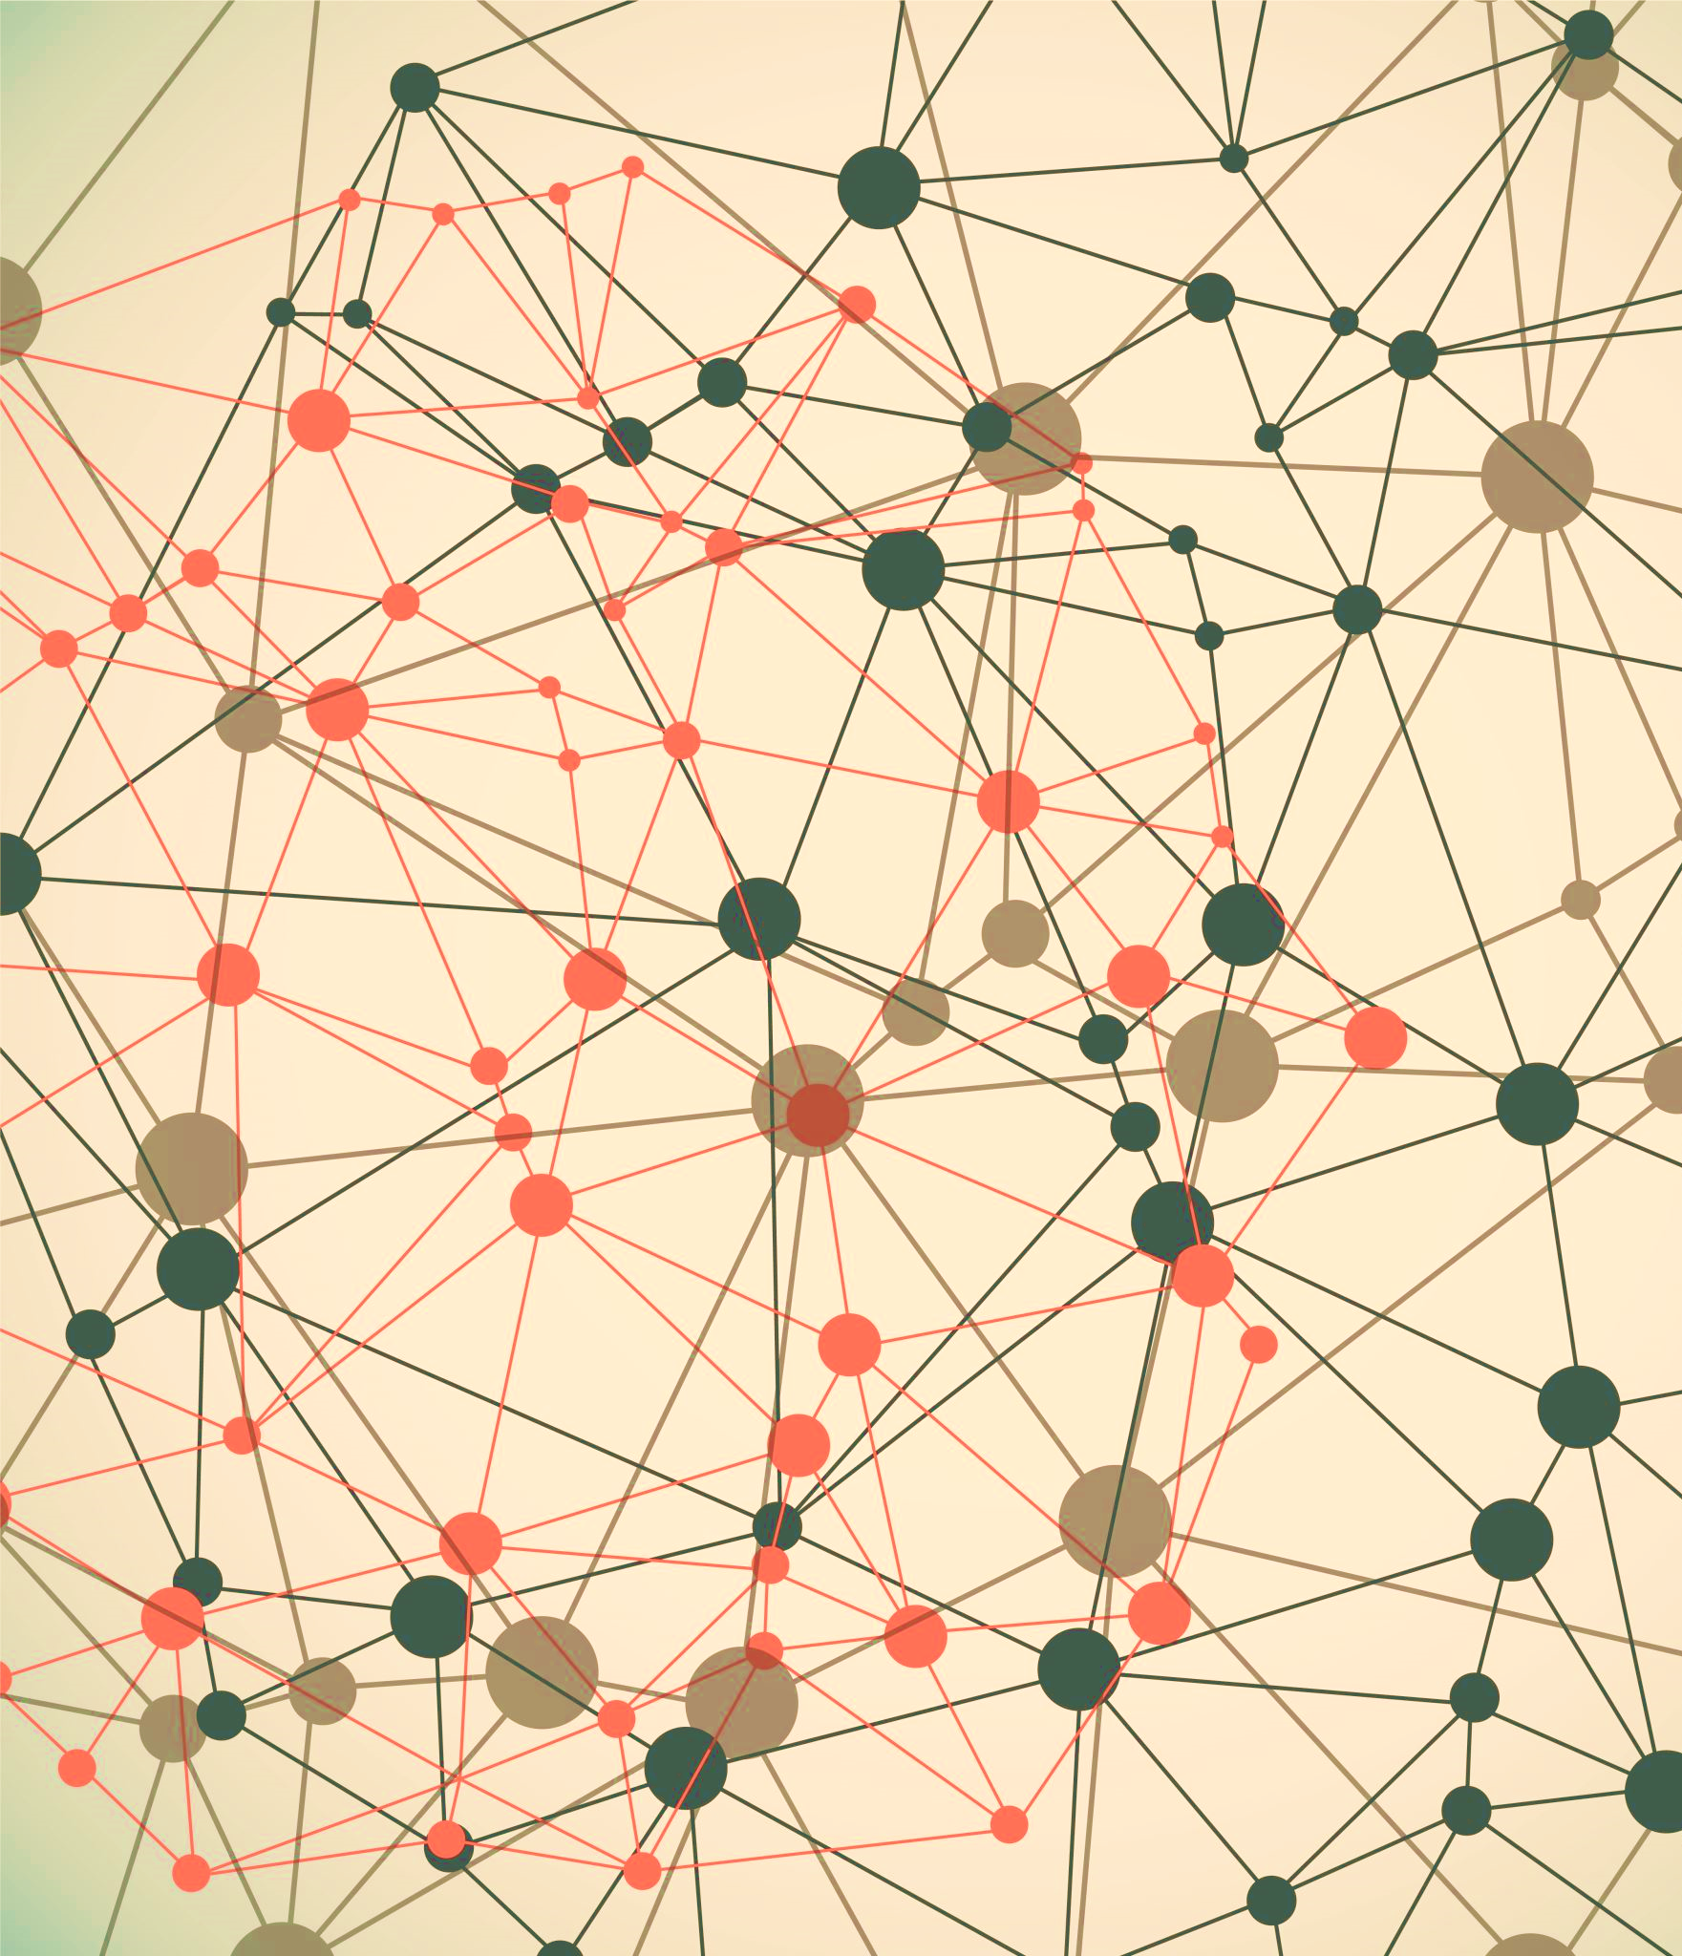
Graph Neural Network for Recommendation System
Heidi Carolina Martinsaari
Maris Häusler
Notes:
Hello!
This project presentation is about Graph Neural Network for Recommendation System. Our project team had 2 members: Heidi Carolina Martinsaari and Maris Häusler.

Slide 2
Problem and Motivation
Problem: What to consume?
Solution: Recommender system
Motivation: Try it ourselves!
Notes:
The problem nowadays is that it gets increasingly harder to orientate in the amount of information and products available. To make life easier for customers and increase the profit of providers, many companies implement recommendation systems.
The motivation behind this project was to try to implement it ourselves from start and to get to better know how this kind of system works using graphs as input.

Slide 3
Dataset
Field | Description
ID | Product ID
ASIN | Amazon Standard Identification Number
Title | Name or title of the product
Group | Product group (Book, DVD, Video, Music, etc.)
Categories | Product category hierarchy
Salesrank | Amazon Salesrank
Similar | ASIN of co-purchased products
Reviews | Product review information: date, user id, rating, total number of votes on the review, total number of helpfulness votes
Amazon product co-puchasing network metadata
548,552 products
1,788,725 co-purchased products
7,781,990 customer reviews
Notes:
In our project we used Amazon product co-purchasing network metadata from 2006. It comes with the information of over 500 000 product IDs and their corresponding Amazon Standard Identification Number (or ASIN for short), Product title, group, category, Amazon Salesrank, almost 1.8 million similar products, and almost 7.8 million customer reviews.
#Similarity - (that get co-purchased with the current product), (people who buy X also buy Y)

Slide 4
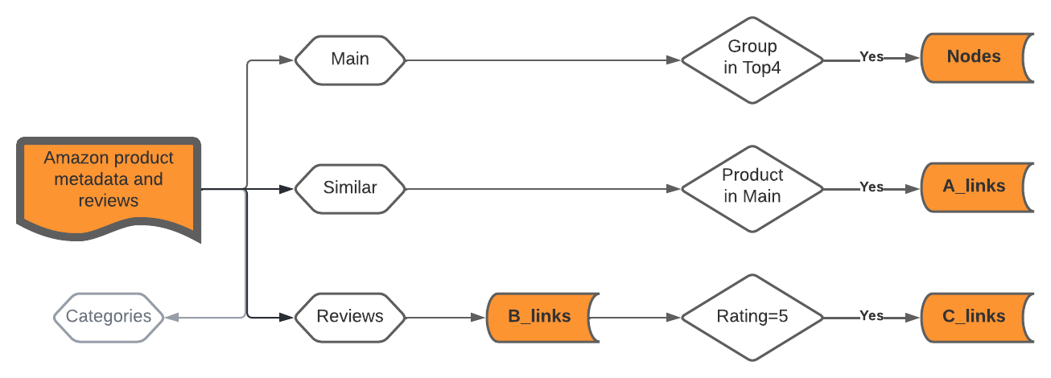
Dataset preprocessing
Notes:
The metadata is used to create 4 different tables.
Main table includes information about the products.
Similar table has information about co-purchased products,
Review includes user reviews about products.
And categories table has the hierarchy of product categories.
From the main table we filtered out products which group was either book, DVD, video or music. And as a result got the node attributes (542 664 nodes).
From similar table we filtered out pairs of co-purchased products for which we have the node attributes and created Amazon product-product edge list called A_links (275 230 edges).
We transformed the reviews table to customer-product edge list for bipartite graph. This we called B_links (410 480 edges).
And from there product-product edge list was constructed for the products that were rated by the same customer, with the restriction that rating must equal to 5. This edge list is called C_links (71 680 770 edges)
We did not use Categories table in this work, but it can be used to improve the system in the future.

Slide 5
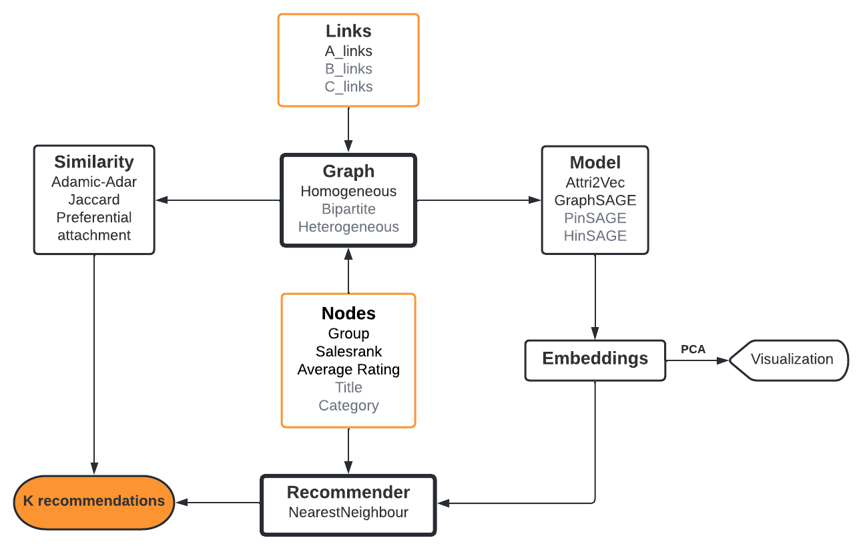
Methodology
Notes:
#Grey out the options we did not use
Here is the flowchart of our methodology.
From the previous slide we saw how to transform the original dataset to nodes and links. Node attributes we found useful are Group, Salesrank and AverageRating. There are also information about title and category available, but these need to be embedded to be used, so we discarded them for now. We also have 3 diferent edgelists. For now, we only use the A_links from Amazon co-purchased products.
From the nodes and links the network graph will be generated. There is data to generate homogeneous, bipartite and heterogeneous graphs. Here we create Homogeneous graph where links represent the similar products taken from source data.
From network Graph we can directly calculate similarity between two nodes or products and use it to compare the results from Recommender system.
On the other side, we use different models to generate embeddings for the nodes. We implement Attri2Vec and GraphSAGE. We tried PinSAGE for Bipartite graph, but ran into some issues. For Heterogeneous graph, HinSAGE can be used.
Generated embeddings give a good way to visualize our data. For this, some dimensionality reduction, such as PCA shall be used.
Embeddings, together with node attributes is the input for our Recommender, that uses NearestNeighbour to find similar products. The result of our project is a recommender system that recommends top K products based on an example product.
-------
A machine learning model is a file that has been trained to recognize certain types of patterns.
Attri2vec – shallow dd
Node2vec?
GraphSAGE – deep nn
HinSAGE – hetero
PinSAGE – bipart
Homogeneous graph where links are between products the same customer has rated them with 5 stars (C_links)
Homogeneous graph where links represent the similar products and the similarity is taken from source data (A_links)
Heterogeneous graph where we have different entity types: Book, DVD, Music, Video

Slide 6
Results
DVD 'Laura':
GraphSAGE embeddings: distance metric minkowski |  | Attri2vec embeddings: distance metric minkowski |  | Metric jaccard similarity:
1. DVD 'Michiganfest 2002': 0.0 |  | 1. DVD 'Michiganfest 2002': 0.0 |  | 1. Video 'Beloved Infidel': 0.011494252873563218
2. Book 'The Pickwick Papers : BBC (BBC Radio Presents)': 0.000214374071219936 |  | 2. DVD 'A Cry in the Dark': 0.017664575949311256 |  | 2. DVD 'The Strange Love of Martha Ivers / Kirk Douglas on Film - A Biography': 0.011494252873563218
3. Book 'Chinese Brain Twisters : Fast, Fun Puzzles That Help Children Develop Quick Minds': 0.0008455562056042254 |  | 3. Book 'The Victorian Nude : Sexuality, Morality, and Art': 0.03080354444682598 |  | . DVD 'The Strange Lov of Martha Ivers': 0.011494252873563218
4. Book 'Cardiovascular Nutrition: Strategies and Tools for Disease Management and Prevention': 0.001189003000035882 |  | 4. Book 'Urodynamics Made Easy': 0.07894101738929749 |  | 4. DVD 'The Strange Love Of Martha Ivers': 0.011494252873563218
5. Book 'Men in the Off Hours (Vintage Contemporaries)': 0.0014744069194421172 |  | 5. Book 'At the Origins of Christian Worship: The Context and Character of Earliest Christian Devotion': 0.10940132290124893 |  | 5. Book 'The Ghost and Mrs. Muir': 0.01149425287363218
GraphSAGE embeddings: distance metric manhattan |  | Attri2vec embeddings: distance metric manhattan
1. DVD 'Michiganfest 2002': 0.0 |  | 1. DVD 'Michiganfest 2002': 0.0 |  | Metric preferential attachment:
2. Book 'The Pickwick Papers : BBC (BBC Radio Presents)': 0.0006997332675382495 |  | 2. DVD 'A Cry in the Dark': 0.04629028973864546 |  | 1. Book 'Diagnostic and Statistical Manual of Mental Disorders DSM-IV-TR (Text Revision) (Diagnostic and Statistical Manual of Mental Disorders)': 6612
3. Book 'Chinese Brain Twisters : Fast, Fun Puzzles That Help Children Develop Quick Minds': 0.0033854282228276134 |  | 3. Book 'The Victorian Nude : Sexuality, Morality, and Art': 0.09402365252271183 |  | 2. Book 'The Prince': 6003
4. DVD 'Doctor Who - The Armageddon Factor (The Key to Time Series, Part 6)': 0.004233678453601897 |  | 4. Book 'Urodynamics Made Easy': 0.18272085501265534 |  | 3. Book 'Publication Manual of the American Psychological Association, Fifth Edition': 5481
5. Book 'Cardiovascular Nutrition: Strategies and Tools for Disease Management and Prevention': 0.004844070761464536 |  | 5. Book 'At the Origins of Christian Worship: The Cotext and Character of Earliest Christian Devotion': 0.25265551014021903 |  | 4. Book 'Taber's Cyclopedic Medical Dictionary -Thumb-Indexed Version': 5220
 |  |  |  | 5. Book 'Confessions (Oxford World's Classics)': 5133
GraphSAGE embeddings: distance metric canberra |  | Attri2vec embeddings: distance metric canberra
1. DVD 'Michiganfest 2002': 0.0 |  | 1. DVD 'Michiganfest 2002': 0.0
2. Book 'The Pickwick Papers : BBC (BBC Radio Presents)': 0.03311719733068732 |  | 2. DVD 'A Cry in the Dark': 0.5346165451500894
3. Book 'Chinese Brain Twisters : Fast, Fun Puzzles That Help Children Develop Quick Minds': 0.05195328033430503 |  | 3. Book 'Exchanging Voices: A Collaborative Approach to Family Therapy (Systemic Thinking and Practice)': 3.011075395037516
4. DVD 'They Were Expendable': 0.08193359036144757 |  | 4. Book 'At the Origins of Christian Worship: The Context and Character of Earliest Christian Devotion': 3.0651762803254474
5. DVD 'More Abba Gold': 0.0852732073470757 |  | 5. Book 'Urodynamics Made Easy': 3.2868988409071904
Notes:
The result of our project is a recommender system that recommends top K products based on an example product.
….

Slide 7
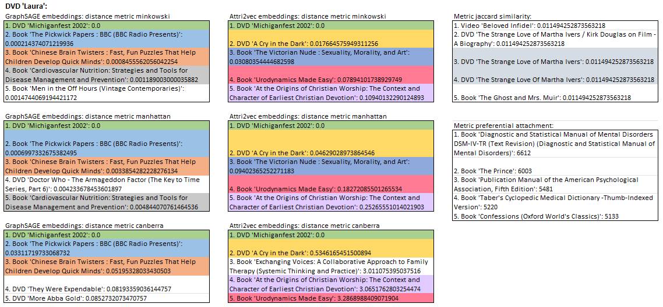
Results
Notes:
Here is an example of 5 recommendation for DVD Laura. Here, the first column has recommendations based on GraphSAGE embeddings, second on Attri2Vec embeddings and third one is based on similarity measures calculated directly from network graph.
Each block has different metric used. So, for embeddings we used minowski, Manhattan and Canberra distance metric. While for similarity we used jaccards similarity and preferential attachment score.
Here, the same recommendations from each configuration is showed in the same color. From the first glance we can see that each model creates totally diferent results (differences in columns) and there is some variation between the metrics (differences in blocks).However, the embeddings play a bigger role here. Only thing in common is that both embeddings generate the first recommendation for DVD LAURA to be DVD Michiganfest 2002.

Slide 8
Conclusions
What did we do?
Future work
Notes:
Our goal was to create a recommendation system ourselves and this worked great. The dataset wasn’t ideal as real world data often isn’t. So the recommendations are sometimes a little questionable from a human perspective.
In this project we transformed the original dataset to diferent edge lists, created diferent types of graphs and tried diferent models to generate embeddings for the nodes. We had more node features and edge lists to create diferent type of graphs than time permitted. For those diferent models for embeddings would have to be used. All these opportunities for future work is shown in the methodology flowchart as grey.
We did invest a decent amount of time to try to implement PinSage for Bipartite graph created using B_links edgelist, but ran into some issues and the results are therefore not shown in this project presentation.
However, we did learn a lot and there is a possibility of master thesis emerging from this work.
The link to our Github repository is also given here.
Thank you!

